Slide 1
Module 6 - Responsive UI & Adaptive Layouts
Notes:
Crafting Flutter UIs that scale beautifully across phones, tablets, and web.
Instructor Note:
Introduce the idea that a single Flutter codebase must handle vastly different screens.

Slide 2
Contents
What Responsive UI means
Screen sizes, device types, and safe areas
MediaQuery for screen information
LayoutBuilder for constraint-based rendering
OrientationBuilder for rotation
Responsive widgets (Expanded, Wrap, Flexible)
Building a real case study: Movie Genre Screen
How to test responsive UI on multiple devices
Notes:
Highlight that this is one of the most practical modules because it affects all UI development.

Slide 3
Why Responsive UI Matters
Flutter runs on:
Small phones
Large phones
Tablets
Foldables
Desktop browsers
Without responsive design:
Overflow errors
Misaligned widgets
Text clipping
Bad user experience
Notes:
Ask students to rotate their emulators now; let them see layout break.

Slide 4
Responsive vs Adaptive UI
Responsive UI: Layout changes depending on available space. Examples:
Column → Row
Grid 2 columns → 4 columns
Padding automatically adjusts based on screen width.
Adaptive UI: Layout changes depending on device type. Examples:
Bottom Nav → NavigationRail on tablet
Drawer → Sidebar on desktop
Code Snippet
if (width < 600) return MobileView();
return TabletView();
Notes:
Keep the difference clear. Students often confuse these two concepts.

Slide 5
MediaQuery: Getting Screen Size
MediaQuery allows you to access device and screen information, such as:
Screen width
Height
Orientation
Safe area padding
Pixel density
Code demo:
final width = MediaQuery.of(context).size.width;
final height = MediaQuery.of(context).size.height;
Notes:
Emphasize that MediaQuery reads the real-time screen size.

Slide 6
Using Breakpoints
Breakpoints help define layout logic.
Example Rule:
< 400px → Small layout
400–800px → Medium layout
800px → Large layout
Code Demo (Runnable):
Widget build(BuildContext context) {
final w = MediaQuery.of(context).size.width;
return Scaffold(
body: Center(
child: Text(
w < 600 ? "Mobile Layout" : "Tablet Layout",
style: TextStyle(fontSize: 24),
),
),
);
}
if (width < 400) return SmallLayout();
else if (width < 800) return MediumLayout();
return LargeLayout();
Notes:
Show 2 simulators side-by-side to demonstrate the switch.

Slide 7
LayoutBuilder
LayoutBuilder gives parent constraints, not full screen size.
Code Example:
Code example:
LayoutBuilder(
builder: (context, c) {
return c.maxWidth > 500
? WideCard()
: NarrowCard();
},
);
LayoutBuilder(
builder: (context, c) {
return Container(
color: c.maxWidth > 300 ? Colors.blue : Colors.red,
height: 120,
);
},
);
Notes:
Stress that LayoutBuilder is perfect for responsive components.

Slide 8
OrientationBuilder
Detects device rotation.
Demo:
Portrait: list
Landscape: two-column layout
OrientationBuilder(
builder: (context, orientation) {
return orientation == Orientation.portrait
? PortraitUI()
: LandscapeUI();
},
);
Notes:
Ask students to rotate the emulator live.

Slide 9
Responsive Widgets Overview
Useful widgets:
Expanded – prevents overflow
Flexible – controls how a child flexes within a Row or Column
Wrap – auto line wrapping
AspectRatio – avoids image stretching
FractionallySizedBox – percent-based size
GridView – multi-column responsive layout
Notes:
Wrap is critical for chip lists → perfect for Genre section.

Slide 10
Responsive GridView
GridView allows building scrollable grids that automatically adapt to screen width by adjusting the number of columns.
Code Example:
GridView.count(
crossAxisCount: width < 600 ? 2 : 4,
);
Mobile: 2 columns
Tablet: 3–4 columns
Desktop: 5–6 columns
Notes:
Great moment to mention Material 3 adaptive grid system.

Slide 11
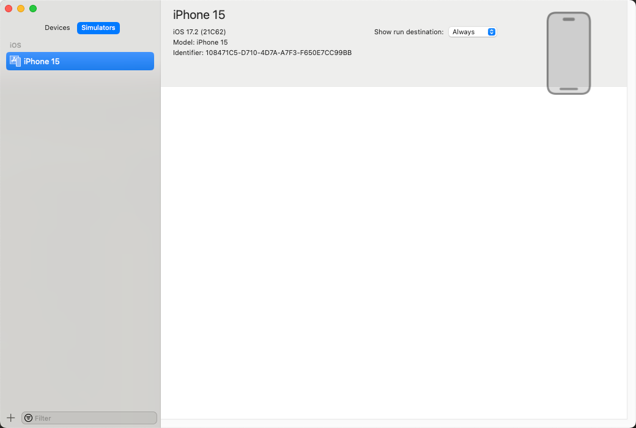
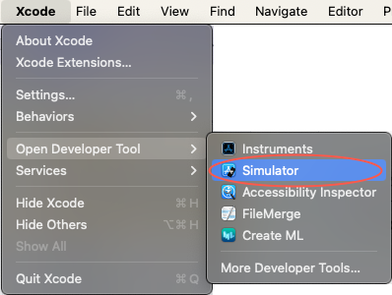
SafeArea & Modern Devices
Dynamic Island / notches / curved screens → Some space cannot be used.
Use:
SafeArea(child: ...)
Notes:
Show Figure 5.11–5.12 to illustrate how UI gets hidden under the notch before using SafeArea.

Slide 12
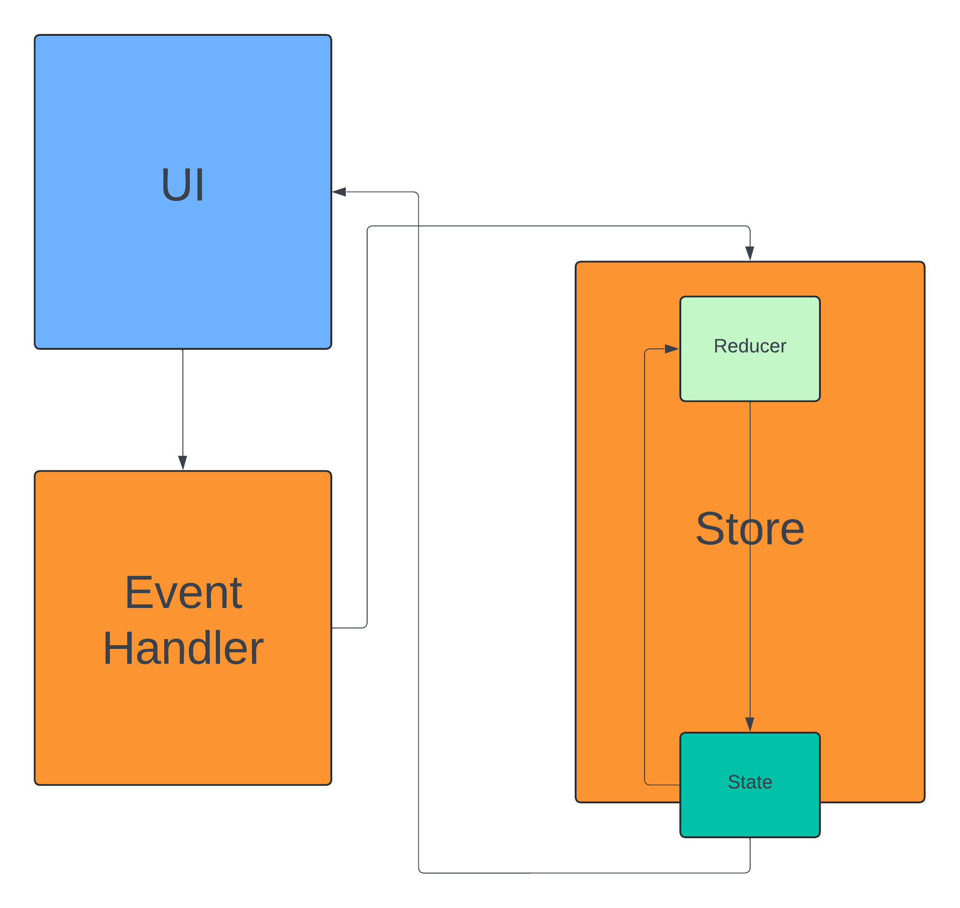
Real Case Study: Genre Screen
We now apply all concepts to a real UI
Notes:
State clearly: Students will recreate this in Lab 6.

Slide 13
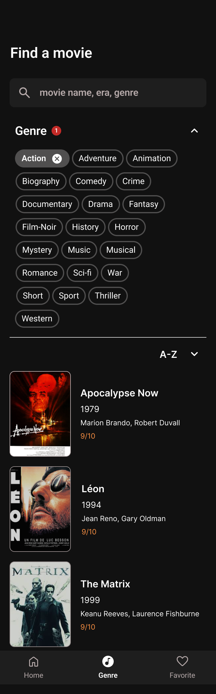
Responsive Search Bar
Key behaviors:
Full width
Padded for large screens
Wrapped in SafeArea
Mini Code:
Container(
padding: EdgeInsets.symmetric(horizontal: 16),
child: TextField(...),
)
Notes:
Students often forget SafeArea here.

Slide 14
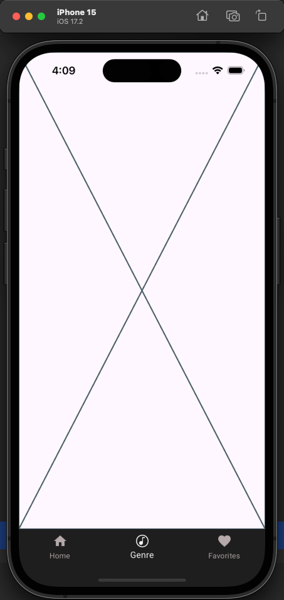
Genre Chips (Collapsed State)
Use the Wrap widget to ensure chips automatically flow to the next line when horizontal space is insufficient:
Wrap(
spacing: 8,
runSpacing: 8,
children: genres.map(_buildChip).toList(),
)
Notes:
Explain selected vs unselected chip styling.

Slide 15
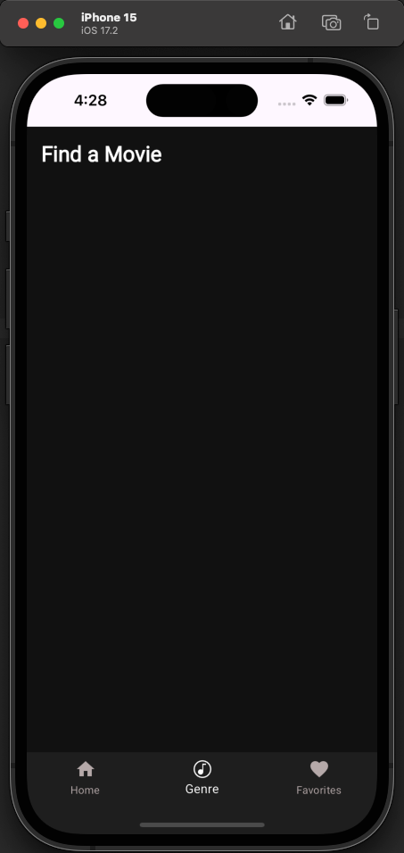
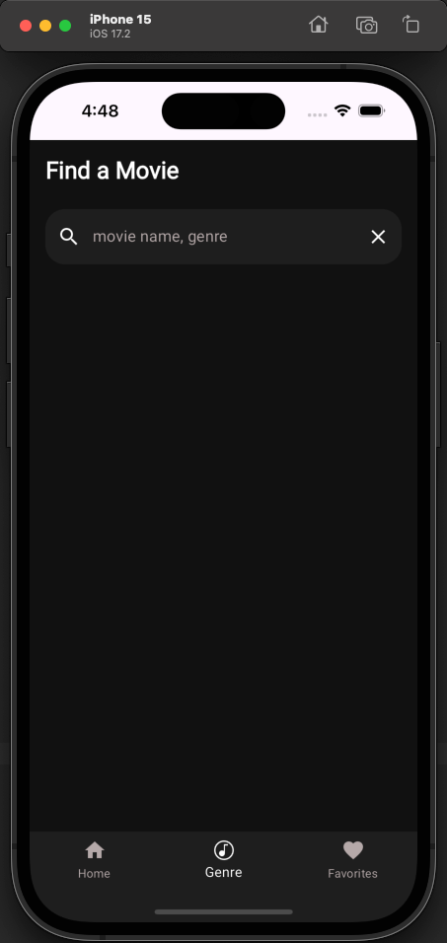
Genre Chips (Expanded State)
Chips wrap automatically
More space → more chips per row
Less space → fewer chips per row
This behavior is achieved automatically by using Wrap, without conditional logic.
Notes:
Highlight that this is responsive by nature — no grid needed.

Slide 16
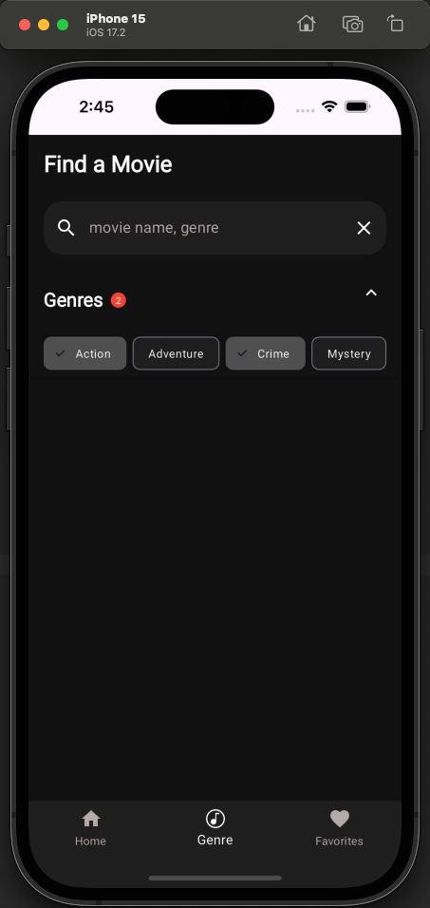
Sort Dropdown
Sorting options include A–Z, Z–A, Rating, and Year.
Code Snippet:
DropdownButton(
value: selectedSort,
items: [...],
onChanged: (v) => setState(() => selectedSort = v!),
)
Notes:
Mention dropdown width auto-adapts to its parent.

Slide 17
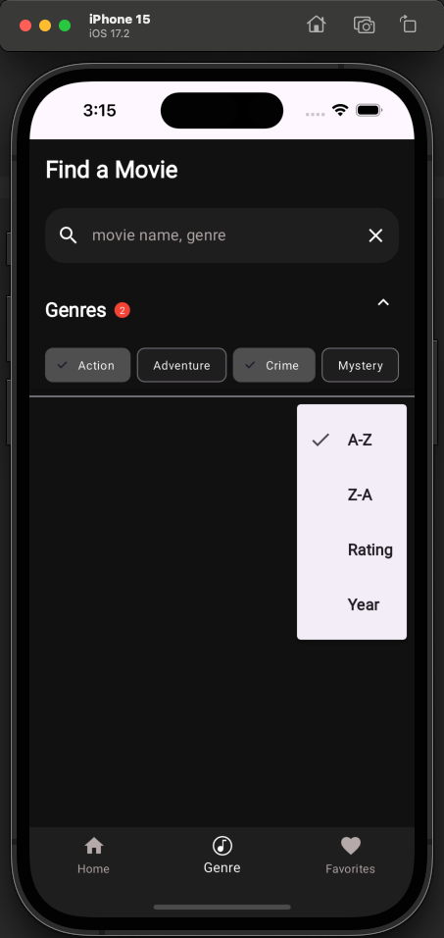
Responsive Movie Card
Code Snippet:
LayoutBuilder(
builder: (context, c) {
final isWide = c.maxWidth > 600;
return Row(
children: [
Image.network(poster, width: isWide ? 150 : 100),
SizedBox(width: 16),
Expanded(child: Text(title))
],
);
},
)
Notes:
Students should notice how poster size adapts.

Slide 18
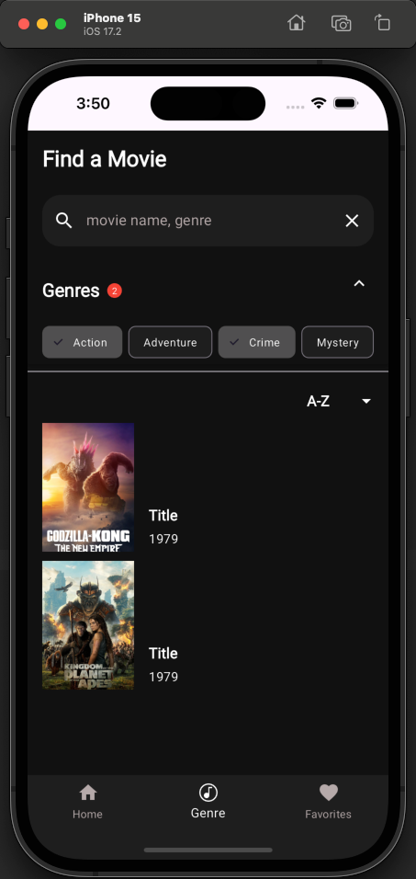
Completed Responsive Screen
Elements included:
Responsive search
Dynamic chips
Sort menu
Responsive movie list
Notes:
This is the final deliverable for Lab 6.

Slide 19
Lab 6.1
Responsive Hero Section
Students must create a responsive home banner.
Width scaling
Height scaling
Breakpoints
Buttons adapt size
Notes:
Provide rough UI sketch; let them design creatively.

Slide 20
Lab 6.2
Rebuild the Genre Screen (Figures 6.1–6.9)
Requirements:
Responsive search bar
Wrap-based chips
Sort dropdown
Movie list responsive
Test on phone + tablet sizes
Notes:
Encourage them to test with Pixel 2 → Pixel 7 → iPad.

Slide 21
Lab 6.3
Tablet Layout Enhancement
For screens > 800px:
Add sidebar filter
2-column movie list
Increased spacin
Notes:
Teach them to use LayoutBuilder at root level.

Slide 22
Best Practices
Avoid fixed values
Use constraints-aware components
Prefer Wrap over Row for long chip lists
Test often on multiple screen sizes
Use Flutter Inspector’s “Layout Explorer”
Notes:
Remind them layout debugging is essential for production apps.

Slide 23
Summary
Responsive vs Adaptive
MediaQuery / LayoutBuilder / OrientationBuilder
Responsive Widgets
Implemented a full responsive Genre screen
Applied GridView and Wrap techniques

Slide 24
References
Mastering Flutter 2025 – Ch.5, 6
docs.flutter.dev
https://dartpad.dev

